Slide 1
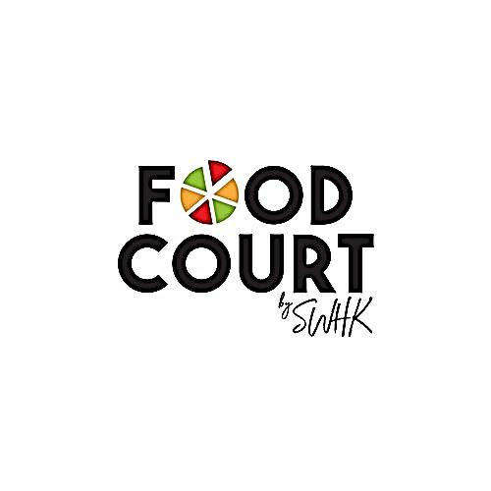
Online Food Ordering WebApp
Astik Singh
B. Tech – C.S.(IV)

Slide 2

What is Online Food Ordering System?
Online food ordering is a system for delivering food from restaurants to the users using websites or mobile apps.
If the user wants food at home, without travelling to the restaurants, he/she can order food online directly through app or website.
Nowadays, more people are opting for online food delivery rather than going out and dine-in. It is helpful for both the user and the restaurant owners.

Slide 3
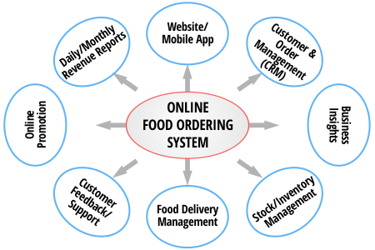
FlowChart

Slide 4

Problem Definition
Looking at the current situation during Covid, more and more people are opting for home food delivery rather than dining out.
So, Online Food Ordering System is the need of the hour. Online food Ordering trend is growing day by day not only because it is convenient but also cost effective.

Slide 5
Abstract
Online Food Ordering System is a website designed primarily for use in the food delivering industry. This system will allow hotels and restaurants to increase their scope of business by reducing the labour cost involved.
The system also allows to quickly and easily manage an online menu which customers can browse and use to place their orders.
Restaurant Employees then use these orders through an easy to navigate GUI for processing.

Slide 6

Screenshots Ahead

Slide 7
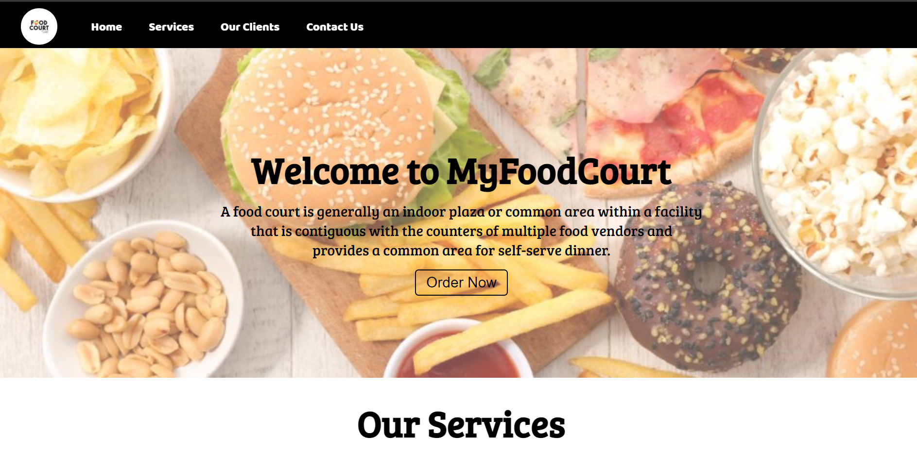

Slide 8
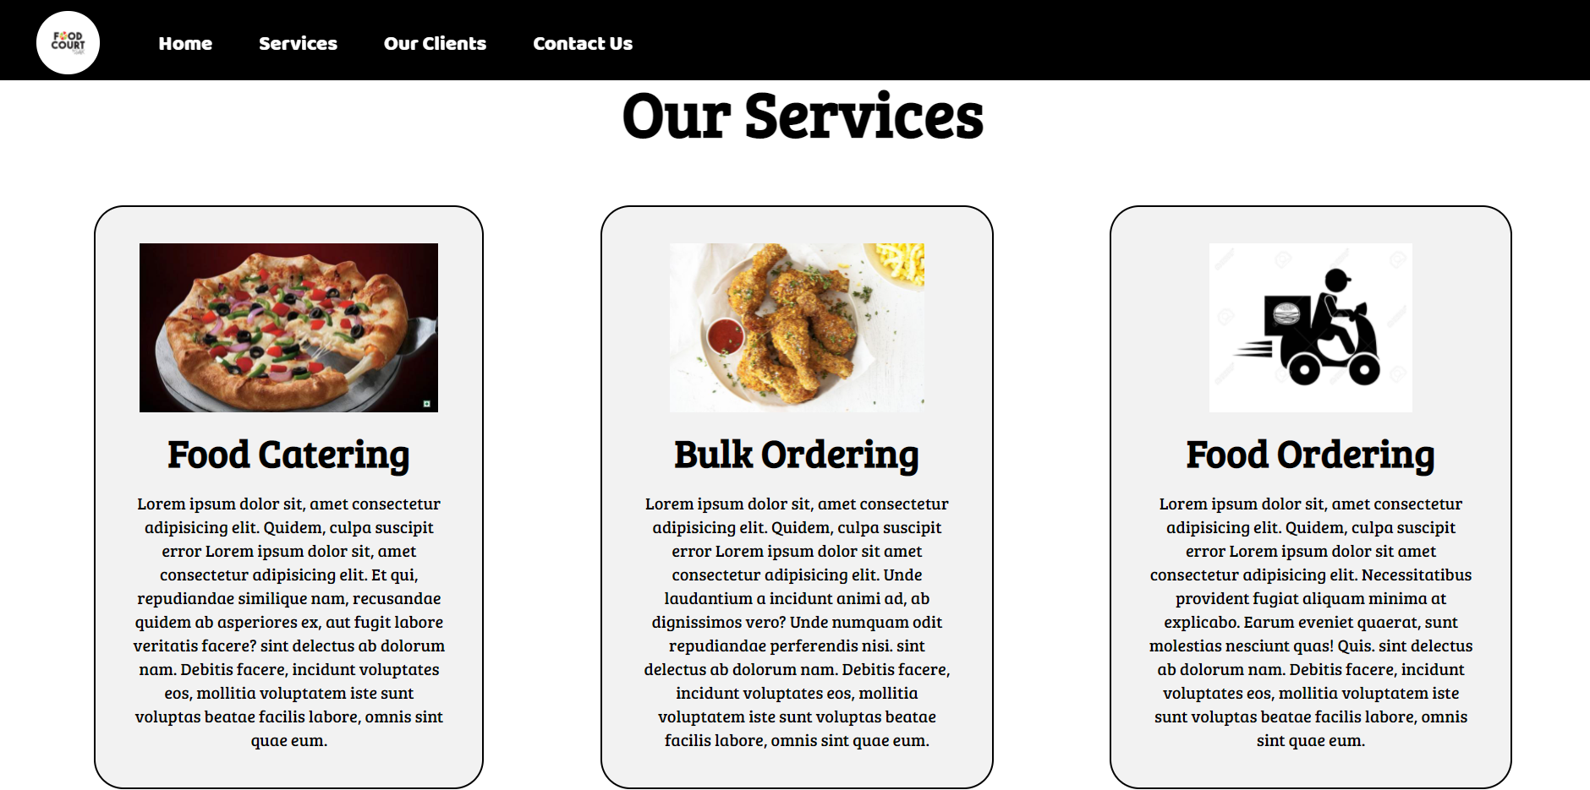

Slide 9
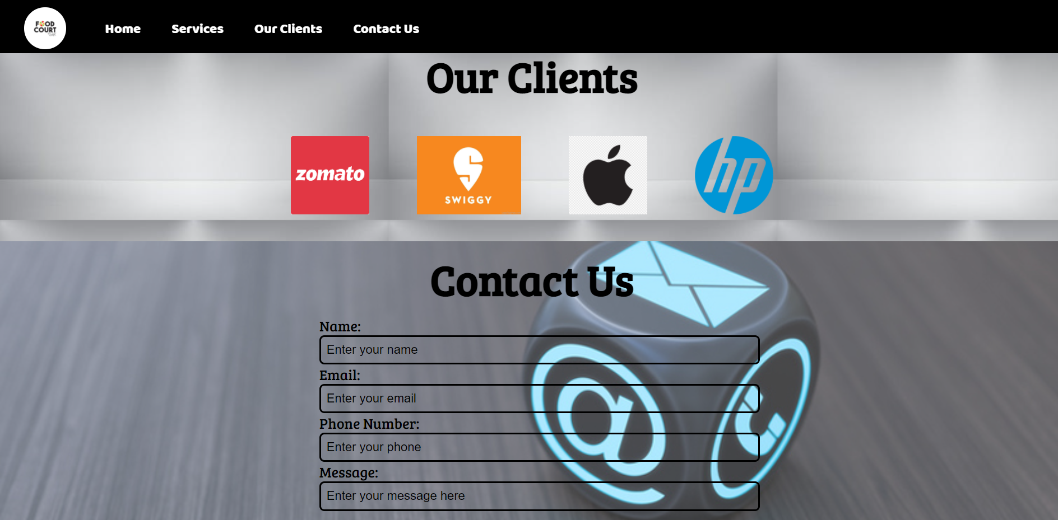

Slide 10
Advantages
More Accuracy and easy order process
Fast, Easy and Comfortable
User friendly
Crush your competitors
No misunderstanding
24*7 Customer Supports
Build your Customer Database

Slide 11

Thank You

